Slide 1
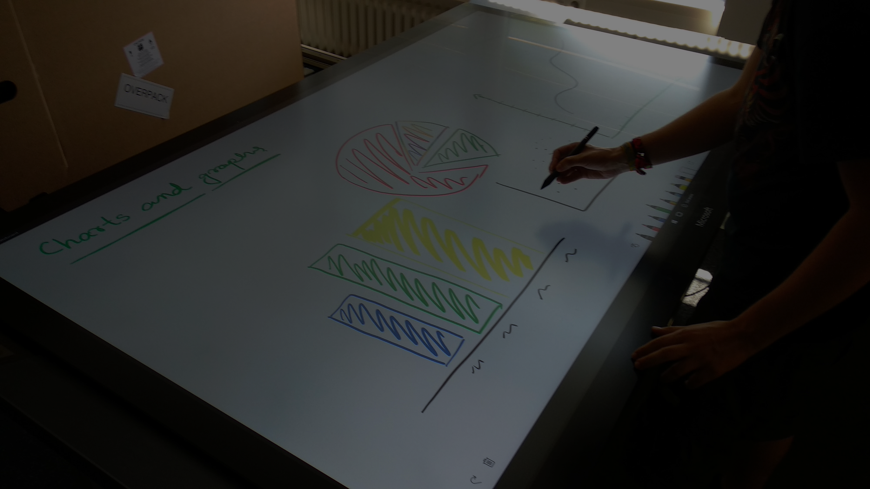


Stages of Social Interaction on Large Interfaces
Arijit Gupta Jakob Strüver
Supervisor: Christian Cherek
Notes:
Introduce ourselves
Name the topic
Reference the picture

Slide 2

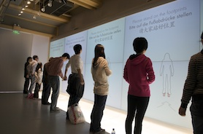
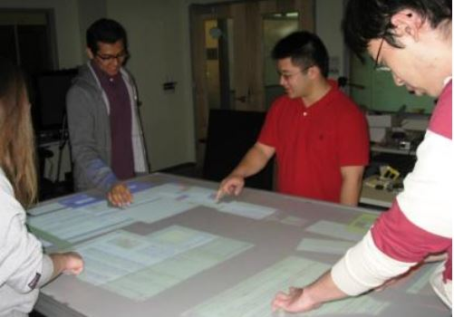
What are they?
In what context?
Why do they exist?
WeSearch: supporting collaborative search and sensemaking on a tabletop display Morris et al. CSCW ‘10
Silhouettes, CAAD and Media Computing Group RWTH Aachen, World EXPO 2010, Shanghai
The eLabBench: an interactive tabletop system for the biology laboratory, Tabard et al. ITS ‘11
2 of 15
Notes:
What? – Interfaces bigger than table Input: gesture based, touch, tangibles – we focus on.
Why? - Large screen real estate, collaborative work…. transition
What context? – private (research). public (public displays). Semi-public (Offices, Schools)

Slide 3
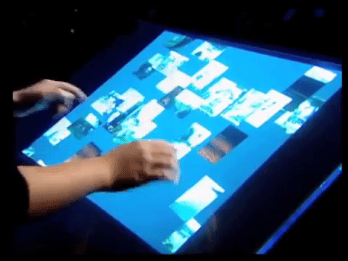
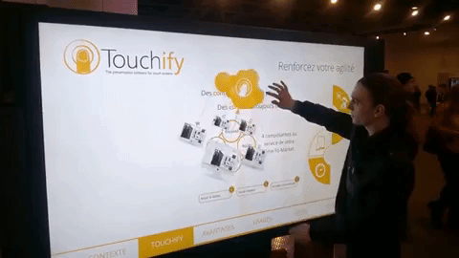
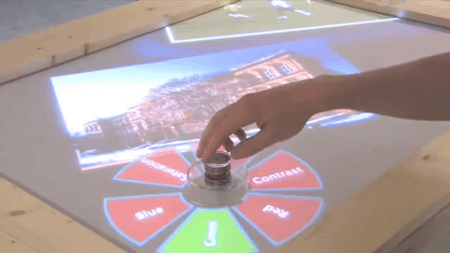
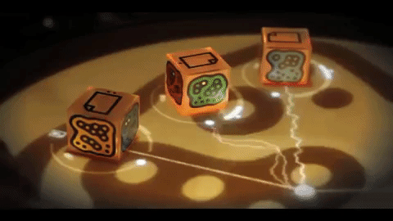
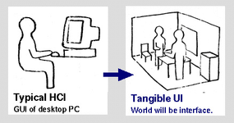
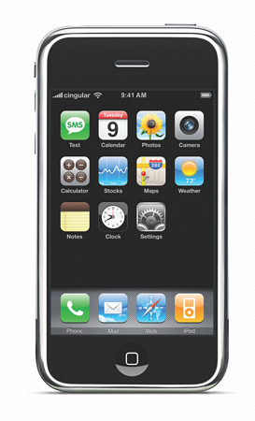
1997
2006
2007
2009
2015
Tangible Bits
Multi-touch
reacTable
SLAP Widgets
Surface Hub
Ishii et al. CHI ‘97
Jeff Han ‘06
Jordà et al. TEI’ 07
Weiss et al. ‘09
Microsoft ‘15
3 of 15
Notes:
1997 - Coined the term TUI. Tangible bits: to map the digital representation of computing back to physical world.
2006 - cheap, scalable multitouch screen, first gestures, bought by Microsoft
2007 – Music control device with Tangibles blocks
2009 - SLAP widgets, just silicone and markers, can be paired with apps
2015 – Commercial product, 84”

Slide 4
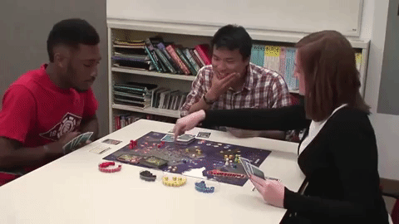
Social Interaction
Communication
Conflict
Cooperation
Supporting Situation Awareness in Collaborative Tabletop Systems with Automation. Chang et al. ITS ‘14
4 of 15
Notes:
What? “A social interaction is an exchange between two or more individuals, it is the process by which we act and react to those around us.”
Communication – Exchange of information
Conflict - Social disagreement
Cooperation – To achieve shared goals

Slide 5
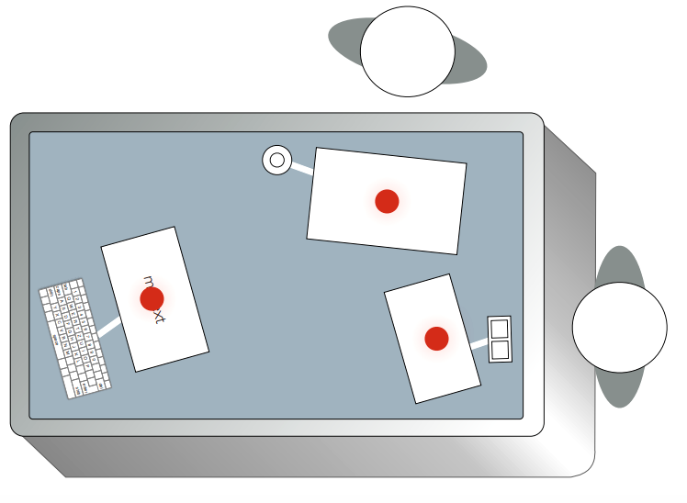
Stages of Social Interaction
#$%^%&%?#
Approaching/
Engaging
the Interface
Disengagement
from the
Interface
Interacting with
the Interface
(Social) Conflicts
and Resolution
5 of 15
Notes:
Why? To study and analyze better
We found multiple models and categorizations of phases in different papers
We found little work on disengagement but we thought it is a natural step of any interaction

Slide 6
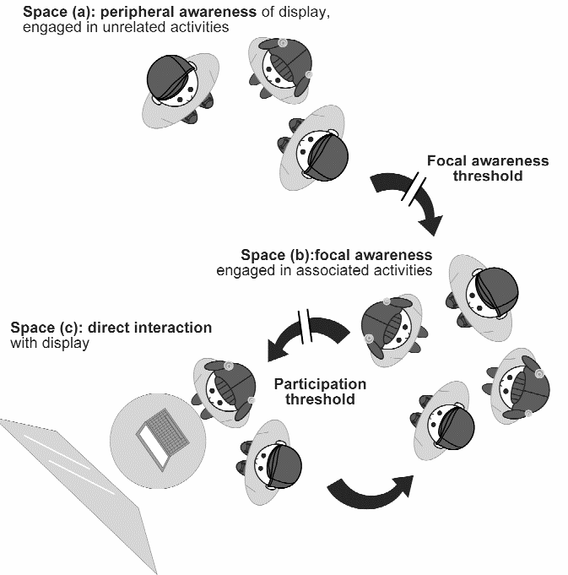

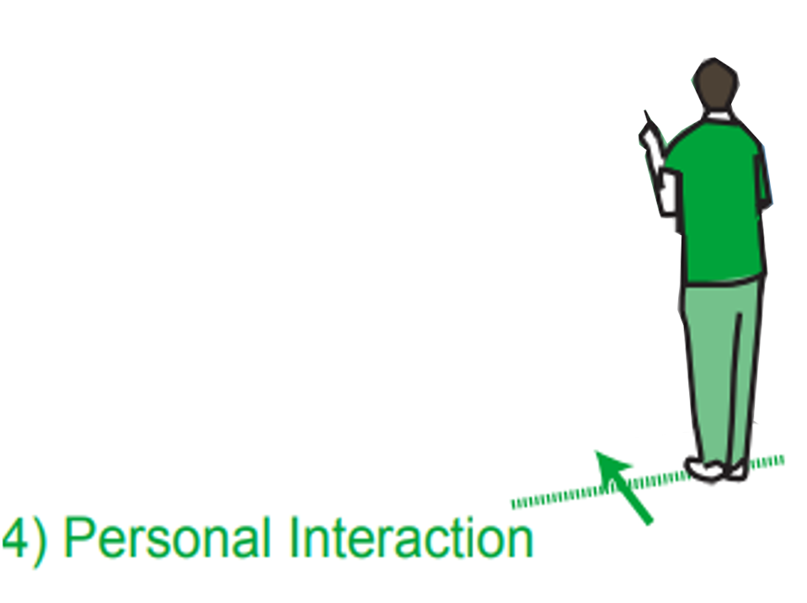
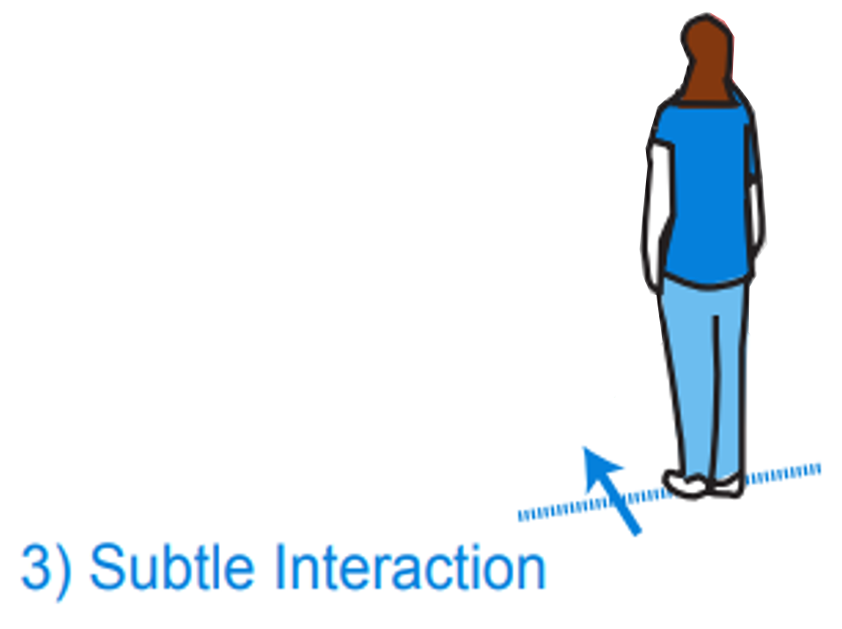
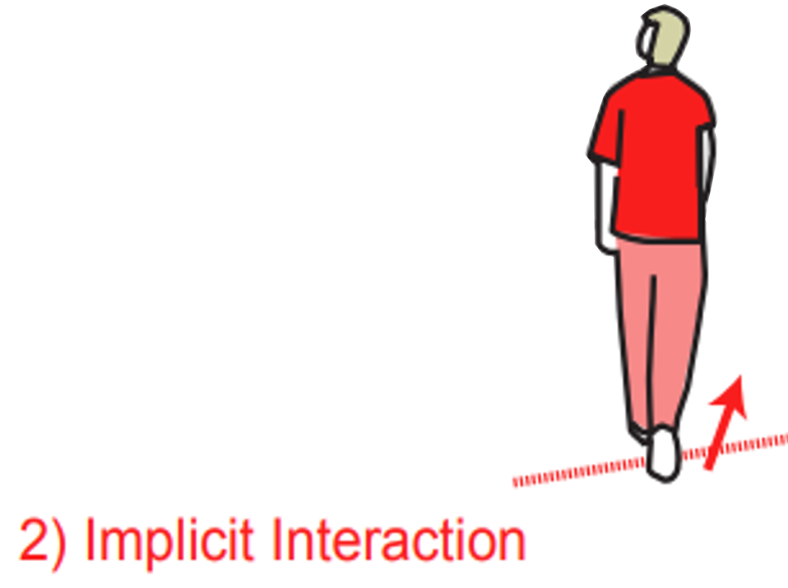
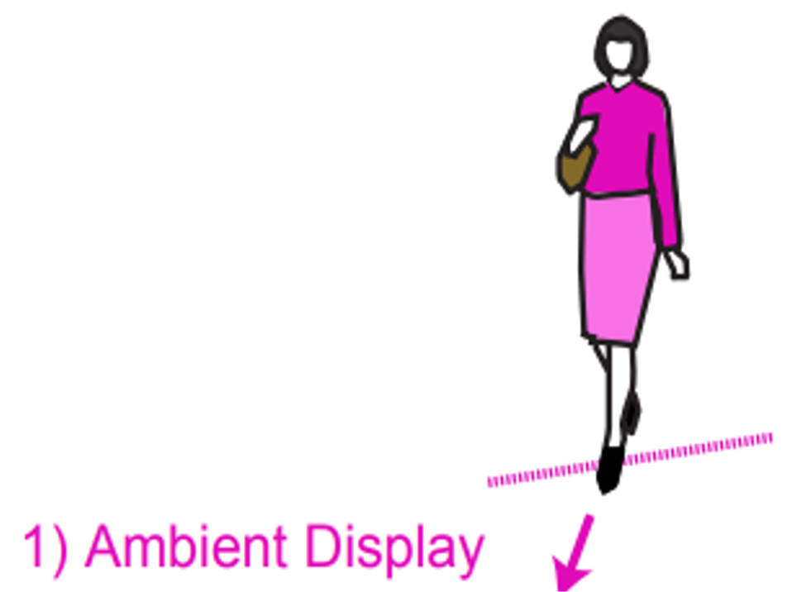
Approaching/Engaging the Interface
Public Interaction Flow Model
Framework for Interaction Phases
Interactive Public Ambient Displays: Transitioning from Implicit to Explicit, Public to Personal, Interaction with Multiple Users. Vogel et al. UIST ‘04
Enticing People to Interact with Large Public Displays in Public Spaces. Brignull et al. INTERACT ‘03
6 of 15
Notes:
physical and social engagement around a large public display.
challenges -> crossing focal awareness thresholds ->peripheral (chatting) to focal (view)
Participation threshold: Focal to direct ???? affordances
Framework for Interaction Phases:
sense of the overall information space with a quick glance.
The user is notified in a subtle manner
detailed notifications current state of the public information
Access personal information

Slide 7
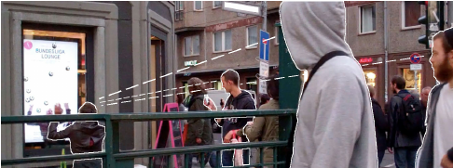
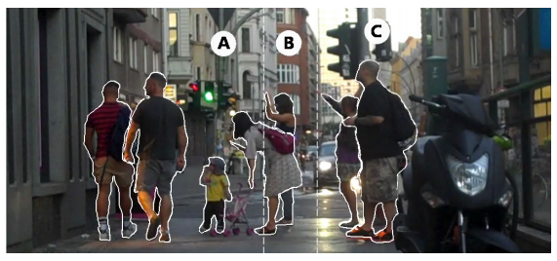
Honey Pot Effect
People noticing a person making uncommon
gestures, and positioning themselves
The Honeypot Effect: Multiple rows
Looking glass: a field study on noticing interactivity of a shop window. Müller et al. CHI ‘12
Enticing People to Interact with Large Public Displays in Public Spaces. Brignull et al. INTERACT ‘03
7 of 15
Notes:
People interacting with a system create a sociable “buzz” around it.
Interests nearby crowd
showing “openness” to discussion and meeting new people
multiple layers of people engaged in different ways
Follow up study in 2016 by Wouters et
Problem with honey

Slide 8
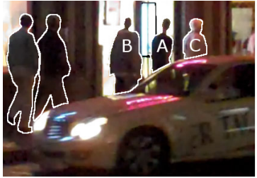
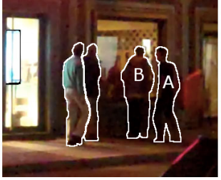
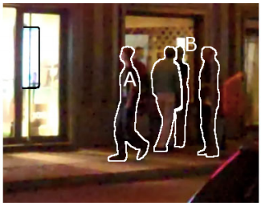
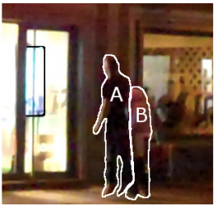
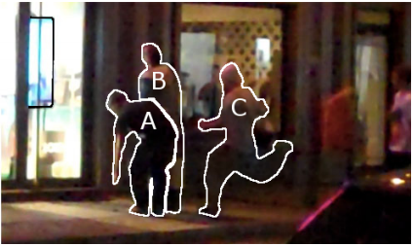
Landing Effect
A, B and C pass by
A stops
A walks back
A interacts
B and C join
Looking glass: a field study on noticing interactivity of a shop window. Müller et al. CHI ‘12
8 of 15
Notes:
Solution. User representation
Leads to The landing effect
Passers-by notice interactive late and have to walk back to interact with a system
Can lead to conflicts because of group dynamics
Loesch et al 2017 built on the idea and used an offset to minimize the landing effect

Slide 9
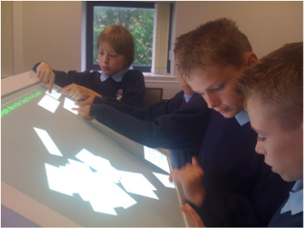
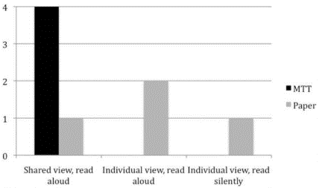
Interacting with the Interface
Number of groups
Students using Multi-touch Surface
Comparison of MTT, Multi-touch Table
Multi-touch tables and collaborative learning. Higgins et al. British Journal of Educational Technology ‘12
9 of 15
Notes:
10- to 11-year-olds school children
Solve mystery task match clues
Statistically not significant performance increase.
Why? Increased social interaction

Slide 10
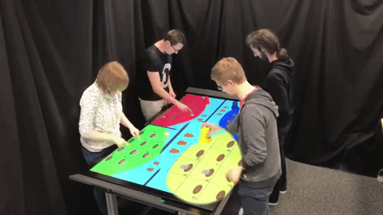
Interacting with the Interface
User B
User A
Awareness through Tangibles
Tangible Awareness: How Tangibles on Tabletops Influence Awareness of Each Other’s Actions, Cherek et al. CHI ‘18
10 of 15
Notes:
Between group study: no user performs both
Tangible physical properties > 2D multi-touch = awareness of other user’s action… can prevent conflicts
Use of tangibles increased awareness of other user (colocated)
User interview -> Auditory feedback moving the tangible
Finding: role of auditory feedback for tangibles is not confirmed

Slide 11
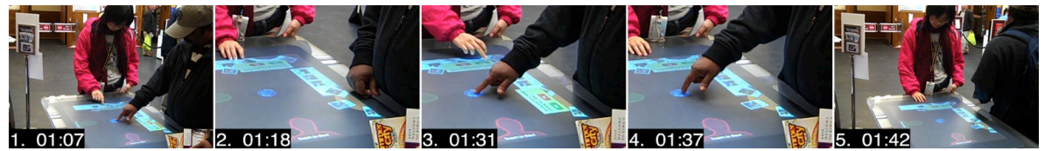
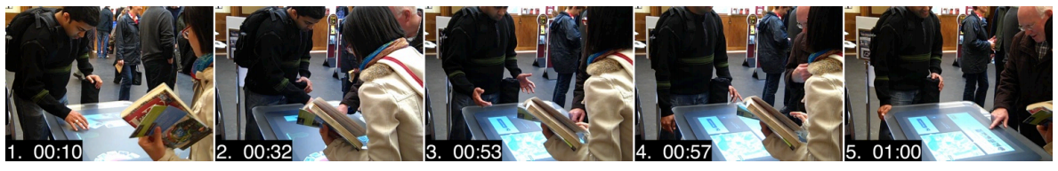
(Social) Conflicts and Resolution
An unresolved clash between strangers
A verbally resolved clash between strangers
Rethinking 'Multi-user': An In-the-wild Study of How Groups Approach a Walk-up-and-use Tabletop Interface. Marshall et al. CHI ‘11
11 of 15
Notes:
Conflicts can occur between users
Info Cards – shared object – notified to users
Conflict usually arise from the design of the system in use (mixing collaborative and non-collaborative parts)
Takeaway positive experiences due to conflicts are rare -> more the exception than the rule

Slide 12
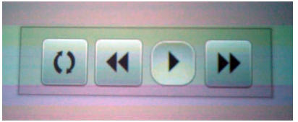
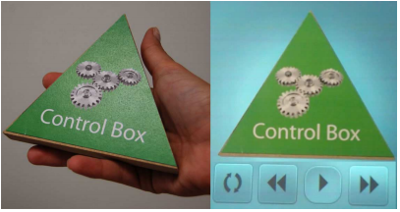
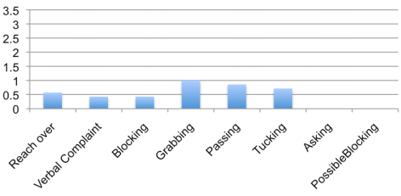
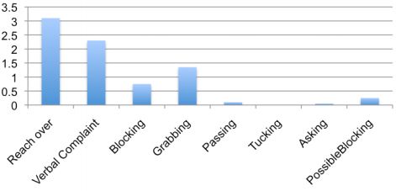
(Social) Conflicts and Resolution
Floating Graphical Toolbar Widget
The Tangible Toolbar Widget
Avg. number
of occurrences
Avg. number
of occurrences
Tabletop with Floating Control Bar
Tabletop with Tangible Control
“It’s just a toolbar!” Using Tangibles to Help Children Manage Conflict Around a Multi-Touch Tabletop, Olsen et al. TEI ‘11
12 of 15
Notes:
Olsen et al, 2011 did a case study of children’s collaborative behavior around a multi-touch tabletop interface.
Using digital widgets led to conflicts over interface elements
Tangible Toolbar widgets, made of wood, led to less conflicts and more turn taking behavior

Slide 13
Disengagement from the Interface
Dropout
Disengagement
Unwillingness
Disappointment
Discomfort
Withdrawal
Completion
Uncovering the Honeypot Effect: How Audiences Engage with Public Interactive Systems. Wouters et al DIS ‘16
13 of 15
Notes:
queuing, time constraints
usability or user experience issues
unfamiliarity, crowdedness
Exhaustion
Completion: depleted all possible interaction possibilities
Aim for diseng. and not dropout. Because it leads to negative UX

Slide 14
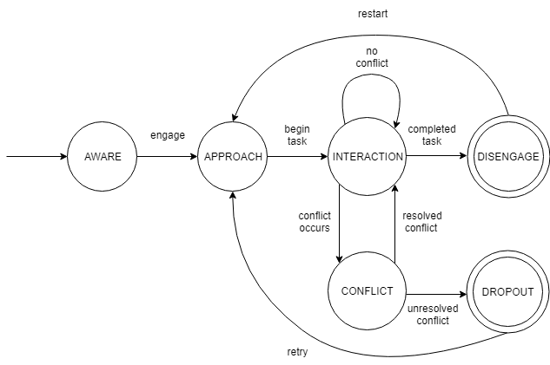
Make it easy to cross Thresholds
Design with Conflicts in mind
Aim for Disengagement, not Dropout
State Diagram of Interaction Stages
14 of 15

Slide 15
References
Meredith Ringel Morris, Jarrod Lombardo, and Daniel Wigdor. 2010. WeSearch: supporting collaborative search and sensemaking on a tabletop display. DOI: https://doi.org/10.1145/1718918.1718987
Aurélien Tabard, Juan-David Hincapié-Ramos, Morten Esbensen, Jakob E. Bardram. 2011. The eLabBench: an interactive tabletop system for the biology laboratory. DOI: https://doi.org/10.1145/2076354.2076391
Y.-L. Betty Chang, Stacey D. Scott, and Mark Hancock. 2014. Supporting Situation Awareness in Collaborative Tabletop Systems with Automation DOI: https://doi.org/10.1145/2669485.2669496
Brignull, Harry, and Yvonne Rogers. "Enticing people to interact with large public displays in public spaces." Proceedings of INTERACT. Vol. 3. 2003.
Daniel Vogel and Ravin Balakrishnan. 2004. Interactive public ambient displays: transitioning from implicit to explicit, public to personal, interaction with multiple users. DOI: https://doi.org/10.1145/1029632.1029656
Jörg Müller, Robert Walter, Gilles Bailly, Michael Nischt, and Florian Alt. 2012. Looking glass: a field study on noticing interactivity of a shop window. DOI: http://dx.doi.org/10.1145/2207676.2207718
Higgins, S. , Mercier, E. , Burd, L. and Joyce‐Gibbons, A. (2012), Multi‐touch tables and collaborative learning. British Journal of Educational Technology, 43: 1041-1054. doi:10.1111/j.1467-8535.2011.01259.x
Christian Cherek, Anke Brocker, Simon Voelker, and Jan Borchers. 2018. Tangible Awareness: How Tangibles on Tabletops Influence Awareness of Each Other's Actions DOI: https://doi.org/10.1145/3173574.3173872
Paul Marshall, Richard Morris, Yvonne Rogers, Stefan Kreitmayer, and Matt Davies. 2011. Rethinking 'multi-user': an in-the-wild study of how groups approach a walk-up-and-use tabletop interface. DOI: https://doi.org/10.1145/1978942.1979392
Izabel C. Olson, Zeina Atrash Leong, Uri Wilensky, and Mike S. Horn. 2010. It's just a toolbar!: using tangibles to help children manage conflict around a multi-touch tabletop DOI=http://dx.doi.org/10.1145/1935701.1935709
Niels Wouters, John Downs, Mitchell Harrop, Travis Cox, Eduardo Oliveira, Sarah Webber, Frank Vetere, and Andrew Vande Moere. 2016. Uncovering the Honeypot Effect: How Audiences Engage with Public Interactive Systems. DOI: https://doi.org/10.1145/2901790.2901796
15 of 15

